Slide 1
MCTE 3104 Mechatronics Interfacing Lab
Session no. 1: Intro to Arduino

Slide 2
Outline
Intro to Arduino
Hardware
Software
Community
Arduino Pinouts
Digital I/O
Analog I/O
Pulse-width modulation

Slide 3
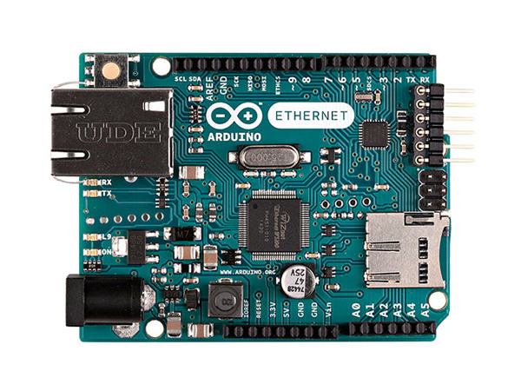
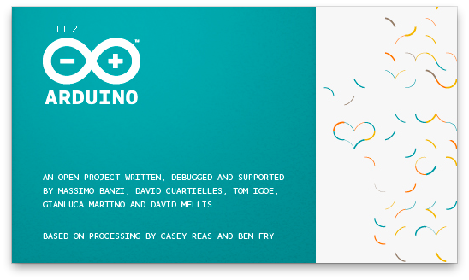

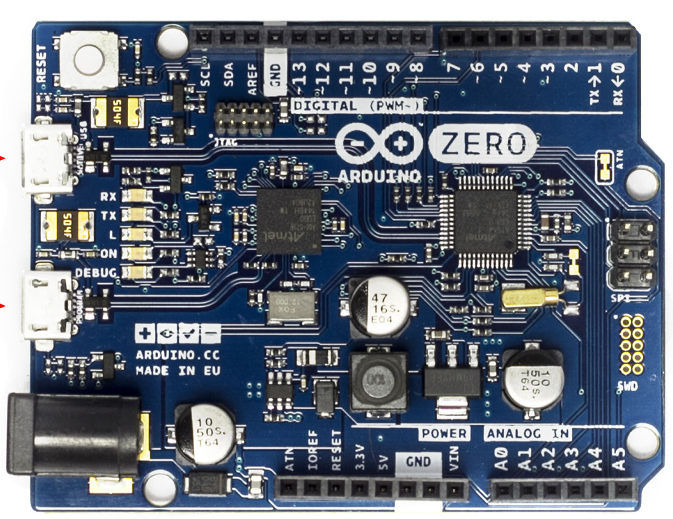
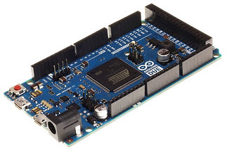
Intro to Arduino:
https://forum.arduino.cc/
https://www.arduino.cc/en/Main/Software
.
.
.
etc

Slide 4
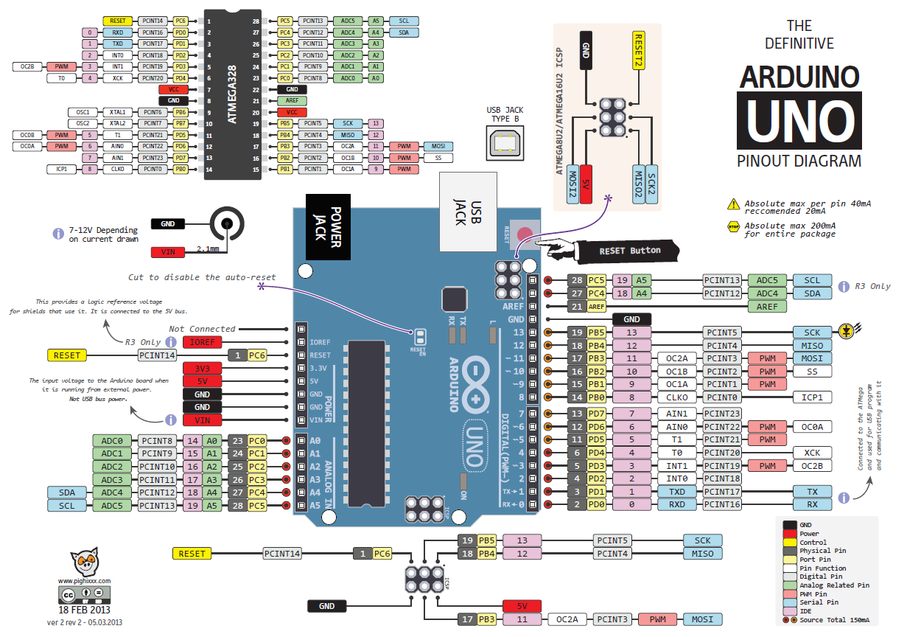

Slide 5
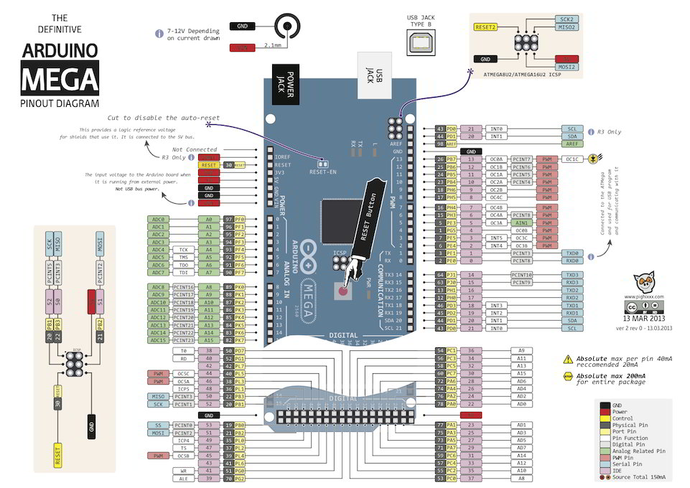

Slide 6
Digital I/O
Digital I/O stand for Digital Input and Output.
Digital Input allows a microcontroller to detect logic states, and Digital Outputs allow a microcontroller to output logic states.
Digital Input: A digital input detects if a voltage is above/below a specific threshold. If the voltage is higher than some value, the microcontroller will detect the digital input as high/set/1. If the voltage is lower than some value, the microcontroller will detect the digital input as low/clear/0.
Digital Output: A digital output allows you to control a voltage with a microcontroller. If the microcontroller instructs the output to be high, the output will produce a voltage (generally about 5 or 3.3 volts). If the microcontroller instructs the output to be low, it is connected to ground and produces no voltage.

Slide 7
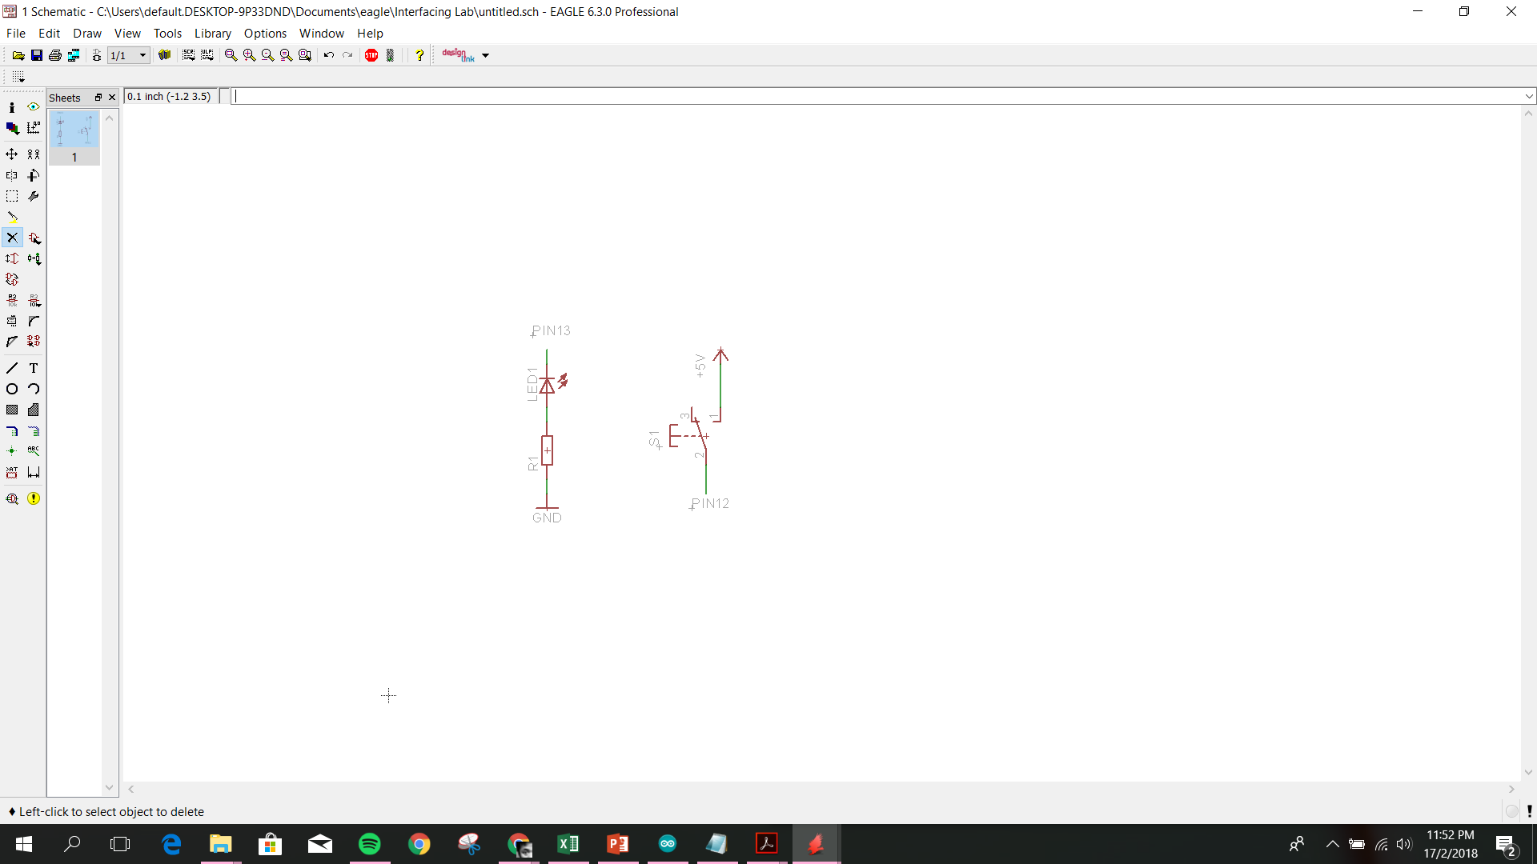
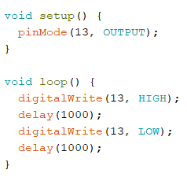
Simple GPIO control using Arduino Library
Example 1: Writing digital output
By default Arduino board has a built-in LED on board connected to pin 13.

Slide 8
Simple GPIO control using Arduino Library
Lab activity 1:
Connect 3 leds to the Arduino. Allow 1 led to blink every 0.5 second, 1 led that blinks every 1 second, and 1 that blinks every 3 seconds.

Slide 9
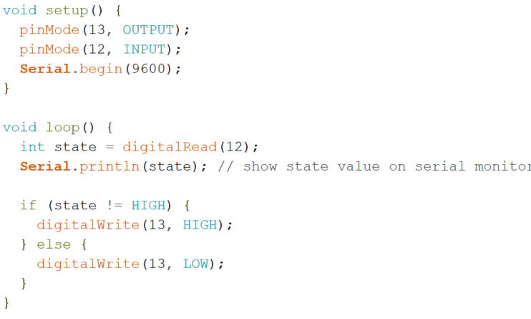
Simple GPIO control using Arduino Library
Example 2: Reading digital input
R2
PIN12
** Any R values below 1k should work

Slide 10
Simple GPIO control using Arduino Library
Lab activity 2:
Using the “Mini Strobe Siren” and linear actuator activate it with a push of a button.

Slide 11
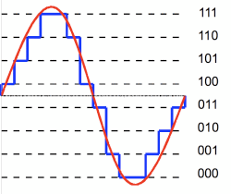
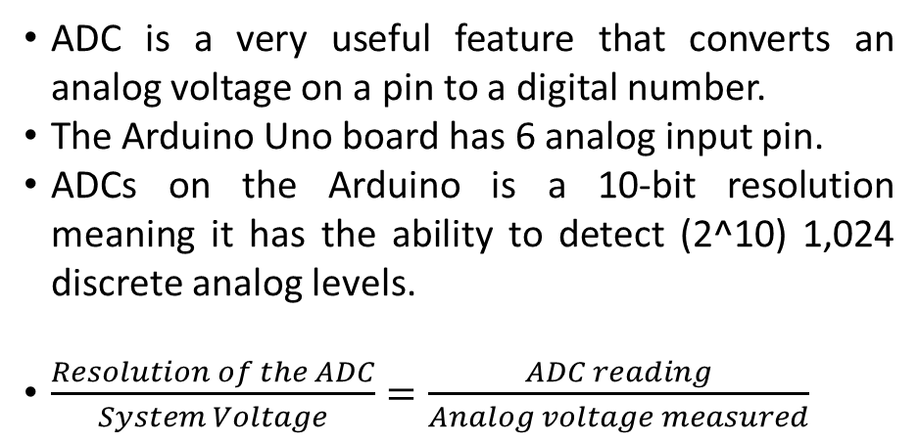
ADC – Analog to Digital Converter
ADC is a very useful feature that converts an analog voltage on a pin to a digital number.
The Arduino Uno board has 6 analog input pin.
ADCs on the Arduino is a 10-bit resolution meaning it has the ability to detect (2^10) 1,024 discrete analog levels.
$\frac{Resolution of the ADC}{System Voltage}=\frac{ADC reading}{Analog voltage measured}$
ADC with 8 steps resolution 2^3 = 8

Slide 12
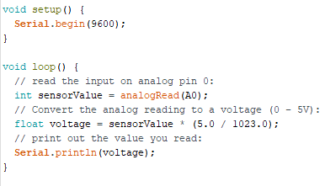
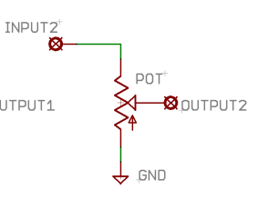
Simple Analog input read using Arduino Library
Example 3: Reading Analog input
5V
A0

Slide 13
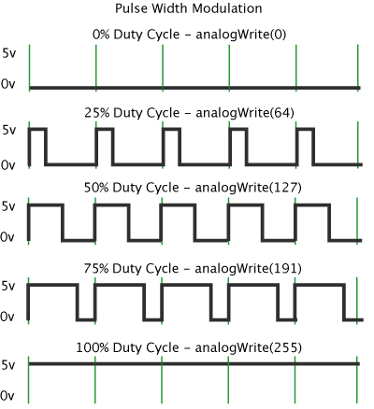
Pulse-Width Modulation
Working principle
Pulse Width Modulation, or PWM, is a technique for getting analog results with digital means. Digital control is used to create a square wave, a signal switched between on and off. This on-off pattern can simulate voltages in between full on (5 Volts) and off (0 Volts) by changing the portion of the time the signal spends on versus the time that the signal spends off. The duration of "on time" is called the pulse width. To get varying analog values, you change, or modulate, that pulse width. If you repeat this on-off pattern fast enough with an LED for example, the result is as if the signal is a steady voltage between 0 and 5v controlling the brightness of the LED.

Slide 14
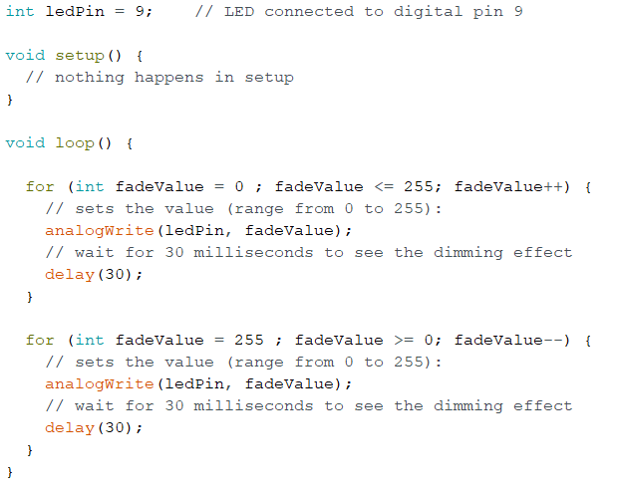
Example 4: Controlling LED brightness

Slide 15
Analog & PWM
Lab activity 3:
Using a potentiometer control the brightness of an led.

Slide 16
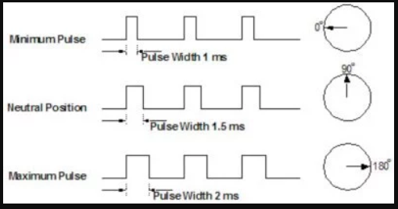
SERVO
Working principle
There is a minimum pulse, a maximum pulse, and a repetition rate.
The servo motor expects to see a pulse every 20 milliseconds (ms) and the length of the pulse will determine how far the motor turns.
A 1.5ms pulse will make the motor turn to the 90° position.
Shorter than 1.5ms moves it in the counter clockwise direction toward the 0° position.
Any longer than 1.5ms will turn the servo in a clockwise direction toward the 180° position.
More reading:
https://www.jameco.com/jameco/workshop/howitworks/how-servo-motors-work.html

Slide 17
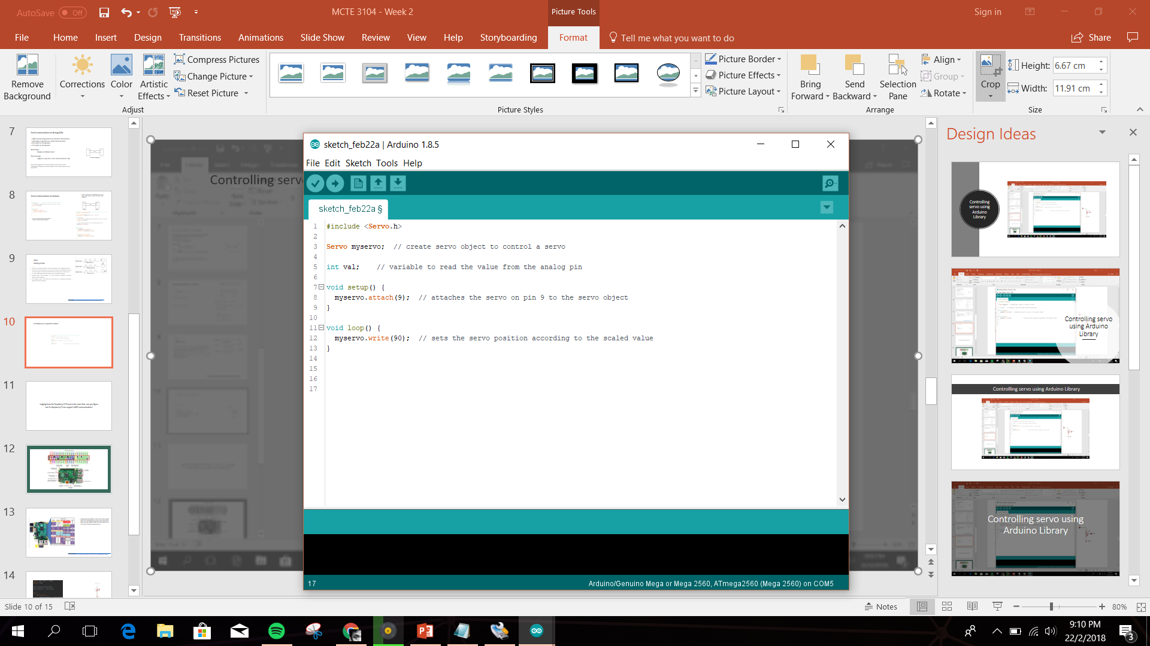
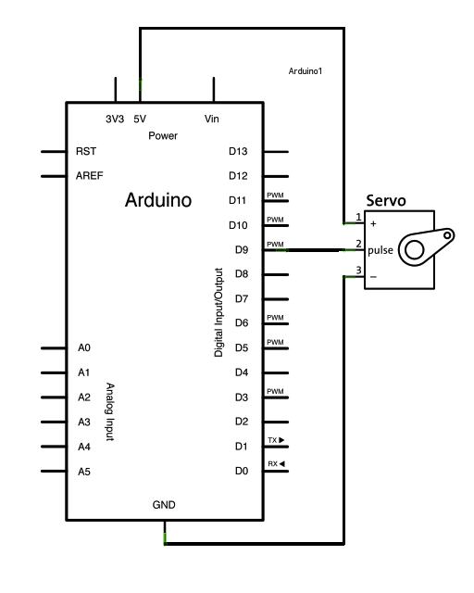
Example 5: Controlling servo using Arduino Library

Slide 18
Analog & PWM
Lab activity 4:
Using a potentiometer control the angle of servo

